Slide 1
Outlook Complex multiphysics/multiscale applications with 4C – Current research projects
Contributors/Researchers of presented topics?

Slide 2
Brief outlook into current applications with 4C Multiphysics
Complex multiphysics example
Multiscale example
Battery example
Biomechanics example

Slide 3
(1) Multiphysics: Problem description
Motivation and physics (formulas)
(One) nice picture
Paper and researcher

Slide 4
(1) Multiphysics: Problem description
Problem setup incl. boundary/initial/coupling conditions

Slide 5
(1) Multiphysics: 4C input file
Add link to input file for download
Spotlight on special sections in 4C input file
1-2 slides

Slide 6
(1) Multiphysics: 4C input file
Add link to input file for download
Spotlight on special sections in 4C input file
1-2 slides

Slide 7
(1) Multiphysics: Results
Pictures/diagrams/videos of results

Slide 8
(1) Multiphysics: Results
Pictures/diagrams/videos of results

Slide 9
(2) Multiscale: Problem description
Motivation and physics (formulas)
(One) nice picture
Paper and researcher

Slide 10
(2) Multiscale: Problem description
Problem setup incl. boundary/initial/coupling conditions

Slide 11
(2) Multiphysics: 4C input file
Add link to input file for download
Spotlight on special sections in 4C input file
1-2 slides

Slide 12
(2) Multiphysics: 4C input file
Add link to input file for download
Spotlight on special sections in 4C input file
1-2 slides

Slide 13
(2) Multiphysics: Results
Pictures/diagrams/videos of results

Slide 14
(2) Multiphysics: Results
Pictures/diagrams/videos of results

Slide 15
(3) Battery: Problem description
Motivation and physics (formulas)
(One) nice picture
Paper and researcher

Slide 16
(3) Battery: Problem description
Problem setup incl. boundary/initial/coupling conditions

Slide 17
(3) Battery: 4C input file
Add link to input file for download
Spotlight on special sections in 4C input file
1-2 slides

Slide 18
(3) Battery: 4C input file
Add link to input file for download
Spotlight on special sections in 4C input file
1-2 slides

Slide 19
(3) Battery: Results
Pictures/diagrams/videos of results

Slide 20
(3) Battery: Results
Pictures/diagrams/videos of results

Slide 21
(4) Biomechanics: Problem description
Motivation and physics (formulas)
(One) nice picture
Paper and researcher

Slide 22
(4) Biomechanics: Problem description
Problem setup incl. boundary/initial/coupling conditions

Slide 23
(4) Biomechanics: 4C input file
Add link to input file for download
Spotlight on special sections in 4C input file
1-2 slides

Slide 24
(4) Biomechanics: 4C input file
Add link to input file for download
Spotlight on special sections in 4C input file
1-2 slides

Slide 25
(4) Biomechanics: Results
Pictures/diagrams/videos of results

Slide 26
(4) Biomechanics: Results
Pictures/diagrams/videos of results

Slide 27

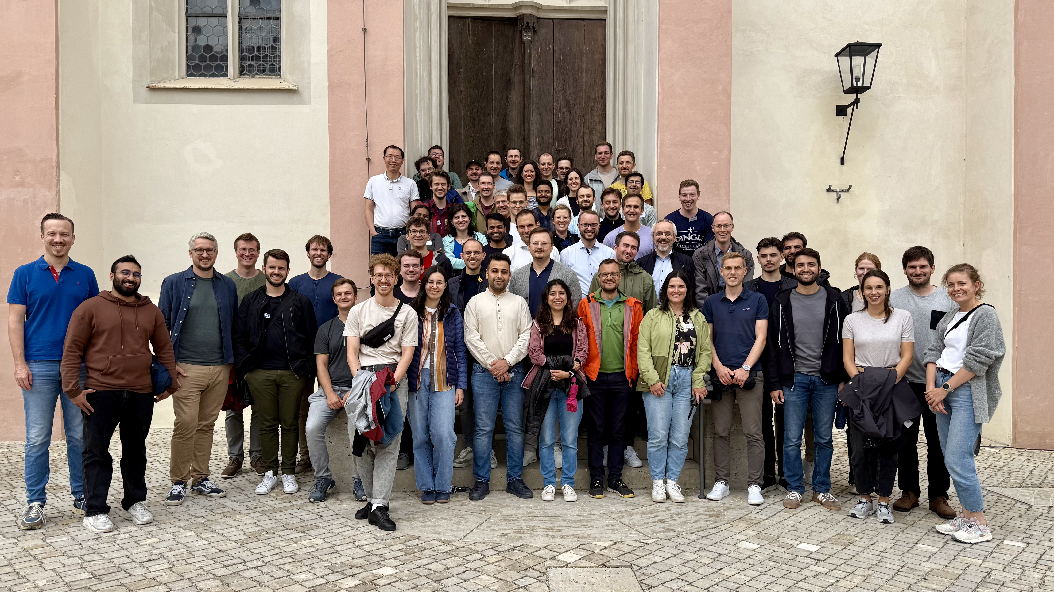
Summary
4C Multiphysics solves challenging real-world applications
Extensible modular C++ software structure
Freely available under LPGL-3.0-or-later
https://github.com/4C-multiphysics/4C
Join the community ☺ (photo from our this year‘s workshop July 29th – 31st, 2025)

